Slide 1
Introduction to
Rmarkdown
Hunyong Cho
Department of Biostatistics

Slide 2

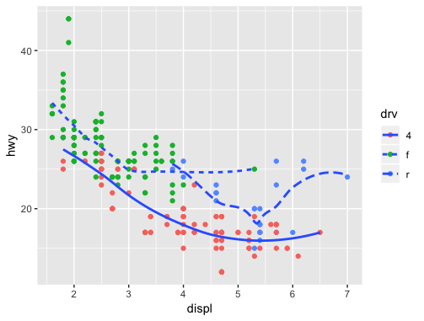
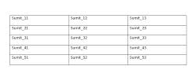
Why need RMarkdown?
R
Documentation
Run codes.
Make plots.
Make tables.
(Word, LaTex, Markdown, PPT, ...)
Copy,
Capture,
Save,
Paste,
Resize,
...

Slide 3
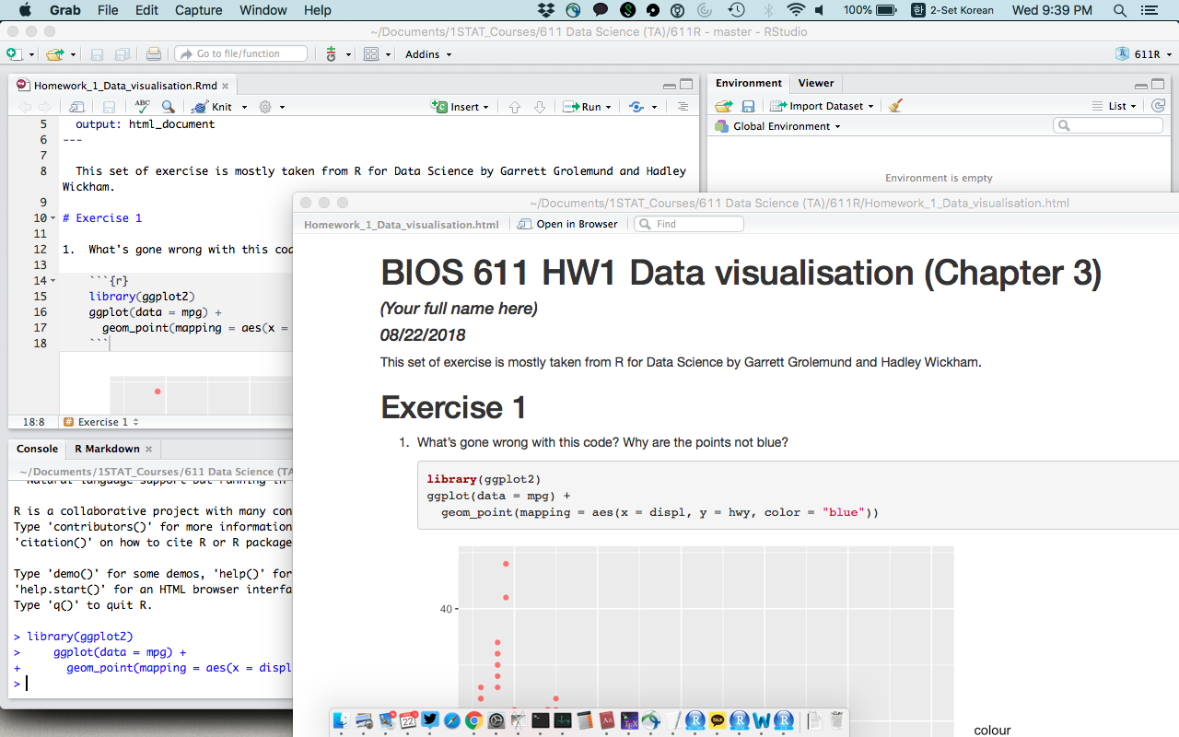
Why need RMarkdown?
RMarkdown = R + Markdown (Documentation)
Coding and documentation at once

Slide 4
What is nice about RMarkdown?
Updating results is handy!
Reproducible research via reproducible documentation
Multiple types of documents (HTML, PDF, DOC, slides, ...)
Codes are easy to read, tables are neat.
Various options of presenting: show code, output, or both show code without running it ...

Slide 5
Getting started

Slide 6
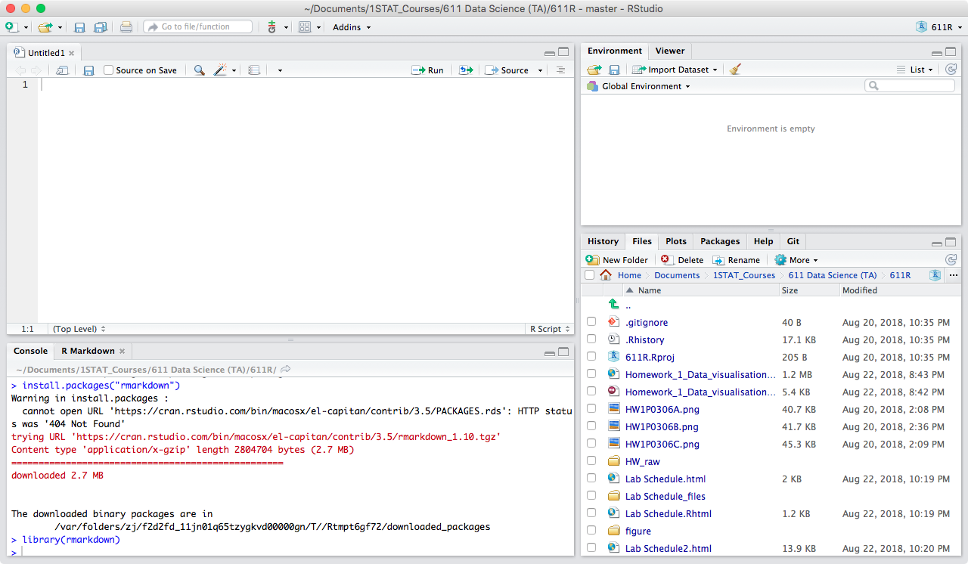
Installing RMarkdown
install.packages("rmarkdown") library(rmarkdown)

Slide 7
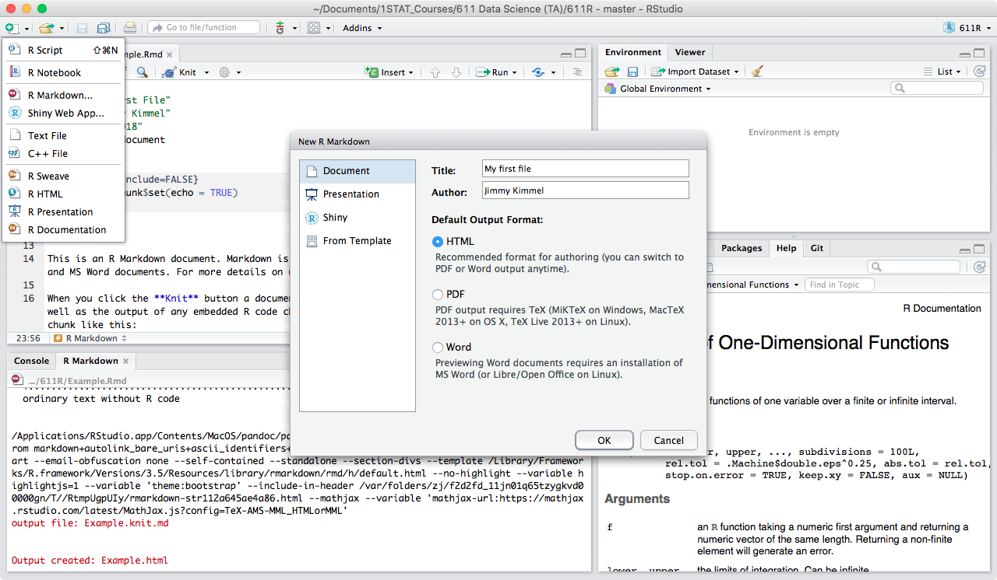
Open a new RMarkdown file (.Rmd)
(Or File > New File) > RMarkdown
For output format, choose “HTML”
Save it Cmd + s (MAC) Ctl + s (Win)

Slide 8
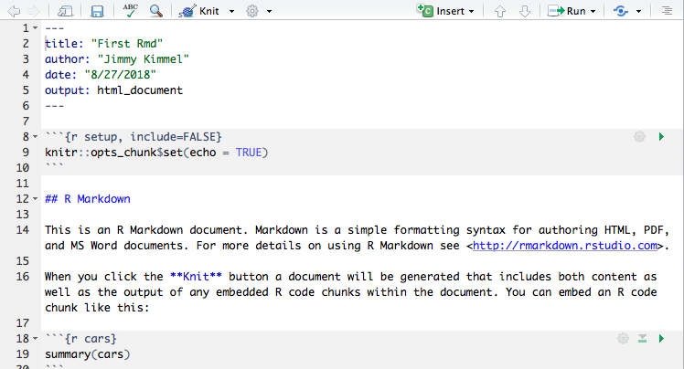
Components of .Rmd
YAML metadata
Code chunks
Texts

Slide 9
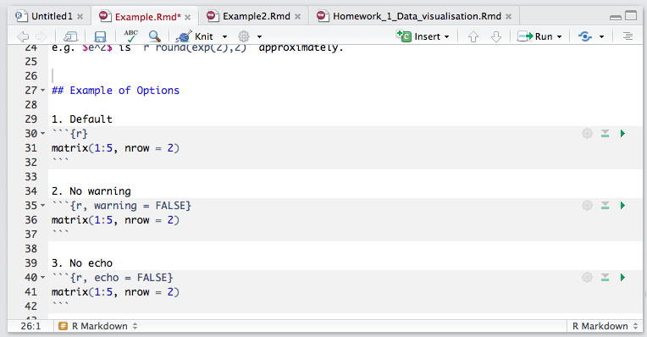
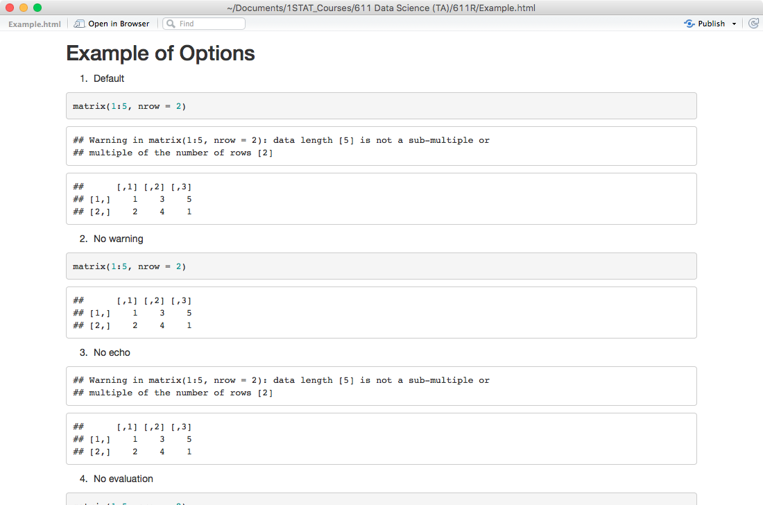
Knit to finalize or Cmd + Shift + K (Mac) Ctrl + Shift + K (Win)
converting texts, codes, and outputs into a readable document
Notes:
Knitting is done by knitr (coversion from Rmd to Markdown) and pandoc (conversion from Markdown to final document).

Slide 10
Let’s write something:
Text

Slide 11
Text - formatting
.Rmd
Output
plain text
# Header One
## Header Two
*italic*
**bold**
***bold italic***
plain text
Header One
Header Two
italic
bold
bold italic

Slide 12
Text - changing lines
To actually change lines, should change lines twice in .Rmd
.Rmd
Output
changed lines once changed lines once changed lines once
changed lines once changed lines once changed lines once
changed lines twice
changed lines twice
changed lines twice
changed lines twice
changed lines twice
changed lines twice
Notes:
Basically, add an extra blank space line in the .rmd file
Or put two spaces at the end of the line (will detect you want a new line character)

Slide 13
Text - lists
.Rmd
Output
* Apple
* Banana
Apple
Banana
1. Apple
2. Banana
Apple
Banana
Notes:
Unordered / Ordered list items.
For ordered, can place multiple 1’s instead of an increasing sequence.

Slide 14

Text - math formula, code, in-line code, ...
.Rmd
Output
$A = \pi \times r^2$
The `dplyr` package
The dplyr package
Three plus three is `r 3 + 3`.
Three plus three is 6.
Don’t know LeTex? Become friends with CrossValidated.
Or some of the basic materials are provided at the end.
Notes:
grave accents (` `) for a piece of code
dollars ($ $) and LaTex language for formulas, Greeks, ...

Slide 15
Text - others
.Rmd
Output
apple^2^
***
End a line with two spaces to start a new paragraph. .
apple²
End a line with two spaces to start a new paragraph.
(New paragraph)

Slide 16
Code

Slide 17
Code chunks - Basics
```{r}
All codes including library, setting working directory, .. should be here!
```

Slide 18
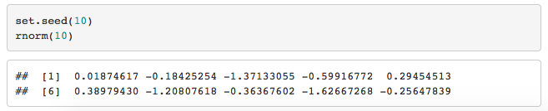
Code chunks - Basics
.Rmd
Output
```{r} set.seed(10)
rnorm(10) ```
Open with ```{r} and close with ``` or Cmd + Opt + i (Mac) Ctrl + Alt + i (Win)

Slide 19
Code chunks - Caution
The RMarkdown file has its own environment
separate from your current R Studio environment!
The RMarkdown file should be standalone, is not dependent on your current environment.
(Wrong example)
(Correct example)
(Correct example 2)
```{r} abc <- c("a", "a", "b", "c") table(abc) ```
```{r} abc <- readRDS("~/Code/dataframe.rds") table(abc) ```
```{r} table(abc) ```
Notes:
Even if you have an object called “abc” in your environment, Rmd file does not know what it is unless it is defined within the file.
You need to do this for each R code chunk.

Slide 20
Code chunks - Caution
For the same reason, every package used should be either loaded on memory (library, require) or specified before functions (::)
(Wrong example)
(Correct example)
(Correct example 2)
```{r} ggplot(iris) ```
```{r} library(ggplot2)
ggplot(iris)
```
```{r} ggplot2::ggplot(iris)
```
Notes:
Even if you have an object called “abc” in your environment, Rmd file does not know what it is unless it is defined within the file.

Slide 21
Code chunks - What are the outputs?
By default,
it echoes the code,
it runs the code,
it shows the result.
But sometimes we only want part of them.
How can we control it?
⇨ Add options next to “r”
```{r, echo = FALSE}
```
Notes:
Even if you have an object called “abc” in your environment, Rmd file does not know what it is unless it is defined within the file.

Slide 22
Code chunks - What are the outputs?
```{r, echo = FALSE, eval = FALSE}
```
Rule | Function
echo = FALSE | prevents code, but not the results from appearing in HTML
include = FALSE | prevents code and results from appearing in HTML
eval = FALSE | prevents code from being run
warning = FALSE | prevents warning message from appearing in HTML
More on R Markdown Reference Guide
Notes:
Even if you have an object called “abc” in your environment, Rmd file does not know what it is unless it is defined within the file.

Slide 23
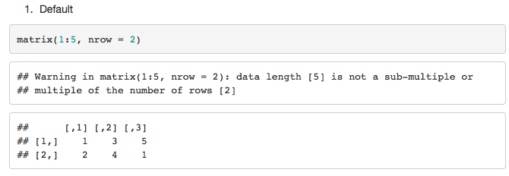
Code chunks - What are the outputs?
1. Default
```{r}
matrix(1:5, nrow = 2)
```
2. No warning
```{r, warning = FALSE}
matrix(1:5, nrow = 2)
```
3. No echo
```{r, echo = FALSE}
matrix(1:5, nrow = 2)
```
Imagine what the other outputs would look like.
and try knitting!

Slide 24
Code chunks - What are the outputs?
4. No evaluation
```{r, eval = FALSE}
matrix(1:5, nrow = 2)
```
5. No include
```{r, include = FALSE}
matrix(1:5, nrow = 2)
```

Slide 25
Code chunks - What are the outputs?
Are these two the same?
5. No include
```{r, include = FALSE}
a = matrix(1:4, nrow = 2)
```
6. No evaluation + No echo
```{r, eval = FALSE, echo = FALSE}
a = matrix(1:4, nrow = 2)
```
5. No include
```{r, include = FALSE}
a = matrix(1:4, nrow = 2)
```
```{r}
a
```
OKAY
6. No evaluation + No echo
```{r, eval = FALSE, echo = FALSE}
a = matrix(1:4, nrow = 2)
```
```{r}
a
```
ERROR!!
Notes:
No. You can’t use “a” later, if you do not evaluate.

Slide 26
Code chunks - What are the outputs?
If you want to control it document-wise,
you can set global options
Later you can override it in individual chunks
```{r setup, include=FALSE} knitr::opts_chunk$set(echo = FALSE)
```
Notes:
Even if you have an object called “abc” in your environment, Rmd file does not know what it is unless it is defined within the file.

Slide 27
Tables, figures, links, ...

Slide 28

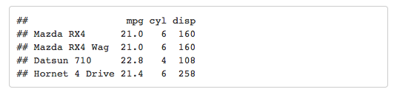
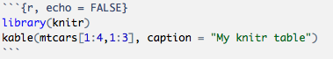
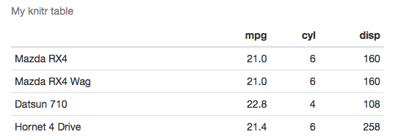
Tables - from an R chunk
1. Simply add the output: not so clean
.Rmd
Output
2. Use “kable” to get nice formats
.Rmd
Output

Slide 29
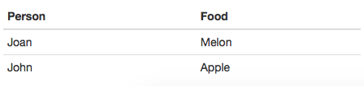
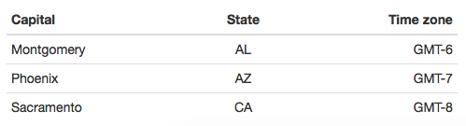
Tables - in your text
.Rmd
Output
Person | Food
--------------- | ----------------
Joan | Melon
John | Apple
Want alignment? Use colons
| Capital | State | Time zone | |:--------|:-----:|----------:| | Montgomery | AL | GMT-6 | | Phoenix | AZ | GMT-7 | | Sacramento | CA | GMT-8 |

Slide 30
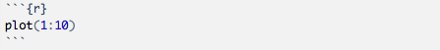
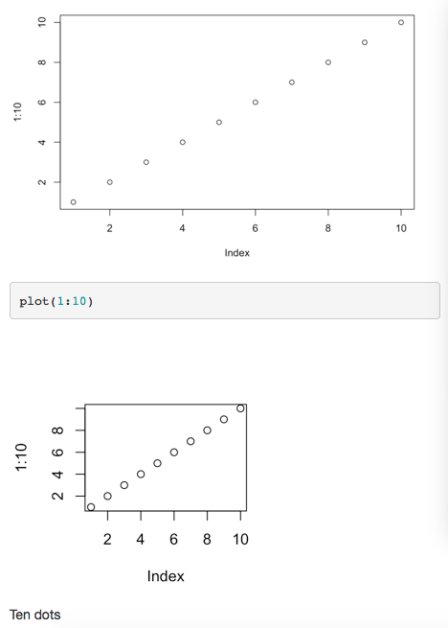

Figures - from a Code Chunk
1. Simply add the output
.Rmd
Output
2. Use options to adjust size, add captions
.Rmd
Output

Slide 31
Figures - Inserting an image
Hyperlinks
.Rmd
Output
![some caption](path/filename.png)
(image with some caption)
.Rmd
Output
[BIOS611 notes](https://biodatascience.github.io/datasci611/)
BIOS611 notes (hyperlink)

Slide 32
RMarkdown resources
RMarkdown Introduction
https://rmarkdown.rstudio.com/lesson-1.html
RMarkdown Cheatsheet
http://www.rstudio.com/wp-content/uploads/2016/03/rmarkdown-cheatsheet-2.0.pdf
RMarkdown Reference guide https://www.rstudio.com/wp-content/uploads/2015/03/rmarkdown-reference.pdf
Latex Getting started https://www.tug.org/begin.html Intro https://www.sharelatex.com/learn/Creating_a_document_in_LaTeX Online tool https://www.overleaf.com/

